Slide 1
Doctoral Writing Group
Literature review therapy session
27th January 2020

Slide 2
What is a Literature review?
1. Literature review as a ‘thing’ - a chapter or sections at the beginning of chapters which give background information necessary to understand your own research
2. Literature review as an ongoing process that happens throughout the doctoral journey, and changes in how you do it throughout the different stages of research

Slide 3
Disclaimer for practice-based artistic researchers: not only scholarly writing…
Lit rev in practice-based artistic research means review of both existing writing and practice, as appropriate to your project
Written literature review materials can come from sometimes contested sources, as long as you give a clear reason for their use and handle them with appropriate care
Some examples:
Sources outside of peer reviewed academia (e.g. music scores, exhibition catalogues);
Trade journals for descriptions of practice/descriptions of debates;
Web sources for describing new phenomena that might not have made it yet into academic discussions (e.g. blogs, social media);
Sources showing how terms or practices are described in professional domains or lay person/public/minority/niche group understandings

Slide 4
Strategic functions of the
Literature review #1
Helps you establish the basis upon which you want your work to be judged
Allows you to:
Locate yourself in a field (disciplinary knowledge and/or field of practice)
Plot your work in a lineage of practitioners/thinkers, and explain how you relate to these people/ideas/debates/artistic practices
Frame your work as research (as opposed to evaluation/market research, etc)
Explain terms, definitions and concepts that you will draw upon when discussing your own work

Slide 5
Strategic functions of the
Literature review #2
Helps you to argue convincingly your claim(s) to originality
you can only make claims to originality in relation to other people
originality claims need to be argued rather than simply stated (as complex as that might be in artistic research)

Slide 6
Strategic functions of the
Literature review #3
Demonstrates to readers (and examiners) your credibility as a researcher
you can be a critical thinker in relation to other people’s work as well as your own

Slide 7
Question
Which problems / issues did you encounter in the lit rev process?

Slide 8
Common problems of writing a literature review
Problems of scope: what to read? What to include?
Structuring as a list/chronology (different ways)
Articulating your authorial voice (through 3rd person)
Emotional work: managing uncertainty and changing identity throughout the research process

Slide 9
“The truth is there is no simple, quick recipe for getting on top of the literatures. It is a slow process of getting clear, a process characterised by uncertainty. And in order to get clear, you have to start out being uncertain. But the bad news is that you stay uncertain throughout the doctorate –even though what it is you are uncertain about changes. So there’s no point fighting it, uncertainty is part of the process. It is usual. It is to be expected.”
Thomson and Kamler, 2016

Slide 12
Literature review as an ongoing process (and not necessarily in this order… but iterative)
1 - ‘Literature survey’ (Evans, Gruba, Zobel, 2014)
2 - ScoMaFo: ‘scoping, mapping, focusing’
3 - CARS: Creating a research space (Thomson and Kamler, 2016)
4 – Developing your authorial voice
Consensus is that in early stage literature work we lack the knowledge of both the wider context of research and of our own research to come to undertake a properly critical lit rev. So be prepared to revise (not just edit)!
Smaller pieces of writing e.g. mini-reviews have a useful function in helping form thoughts; don’t skip this stage!

Slide 13
Stage 1 - ‘Literature survey’
“Once I have a broad grasp of what a paper is about, I begin to look at issues such as whether the results really support the conclusions and whether the experiments look robust. A big question is whether the work is significant; some papers are genuinely remarkable, but most are an incremental contribution and need to be analyzed from that perspective". (Evans, Gruba, Zobel, 2014)

Slide 14
Reading with Critical Synopsis Questions (Wallace and Wray, 2017)
Why am I reading/ listening to / looking at this?
What are the authors / practitioners trying to achieve in writing this?
What are the authors claiming that is relevant to my work?
How convincing are these claims, and why?
In conclusion, what use can I make of this?

Slide 15
Exercise 1
Think of an object / book / paper / work of art that are relevant to your topic
Write down three sentences to explain why

Slide 16
Stage 2 - Scoping, Mapping, Focusing In (ScoMaFo):
Scoping: finding what’s out there
Mapping: sorting and grouping into categories
Focusing In: working with a selection of texts most useful to your research topic
A: Don’t aim to include everything you have read

Slide 17
Mapping the field: building a ‘collective library'
Pierre Baynard (2007), How to talk about books you haven’t read (in Thomson and Kamler, 2014)
‘Collective library’ - all of the texts available on a particular topic
We need to understand how a piece of literature fits into the overall collective library rather than try to read every single piece of literature
‘Inner library’ - a subset of the collective library, including those books which have made a deep impression on the reader and those which are most useful and used for your topic.

Slide 18
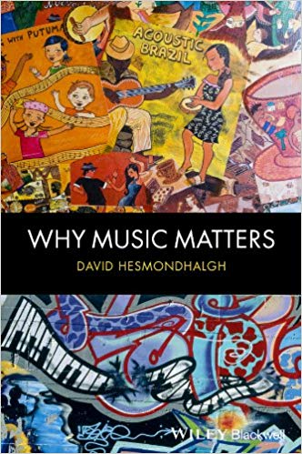
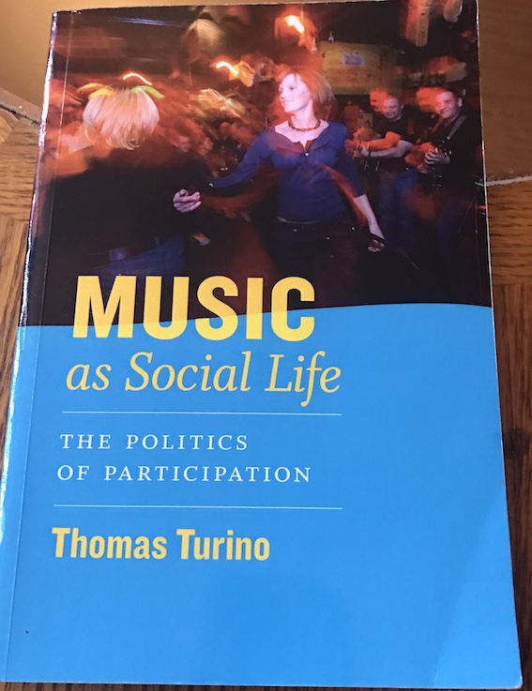
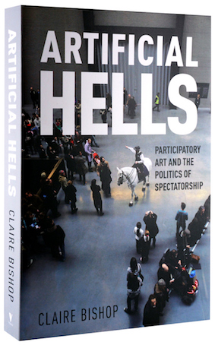
Inner or collective library?

Slide 19
“The more the reader understands key texts, histories of ideas, debates, traditions and trends within the discipline and field generally, the greater the appreciation and understanding of what is written.”
– Thomson and Kamler 2016

Slide 20
Focusing In
What is the history of research in the field? Where has it come from and why this route?
What are the key debates in the field?
Who are the key figures in the field and why?

Slide 21
Stage 3 - Creating a research space
(CARS)
Creates a warrant/mandate for the research
ESTABLISH TERRITORY IN WHICH YOUR WORK IS LOCATED
E.g. how does your topic/practice sit within current practice/policy/debate?
How does your approach contrast with popular opinion/received wisdom?
ESTABLISH A NICHE FOR YOUR RESEARCH (i.e. aesthetic domain)
Can you make a counter claim to current practice/policy/debate?
Or a new theoretical take? Point out a contradiction or tension?
Suggest your research will extend a promising new direction in research/practice?
FILL THE NICHE YOU HAVE CONSTRUCTED
Briefly outline what you will do

Slide 22
Exercise 2
Detect CARS model in the abstract(s)

Slide 23
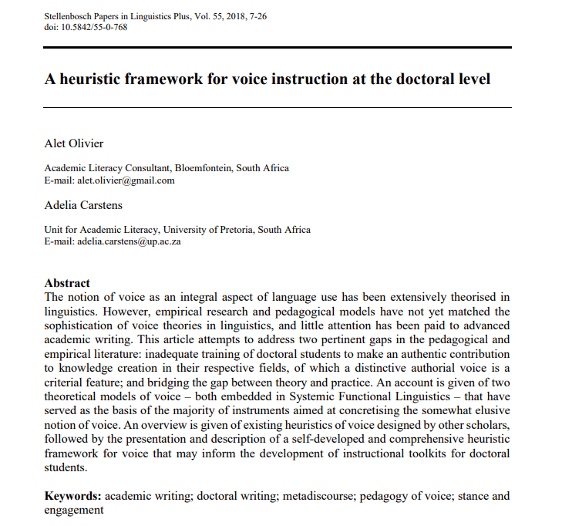

Slide 24
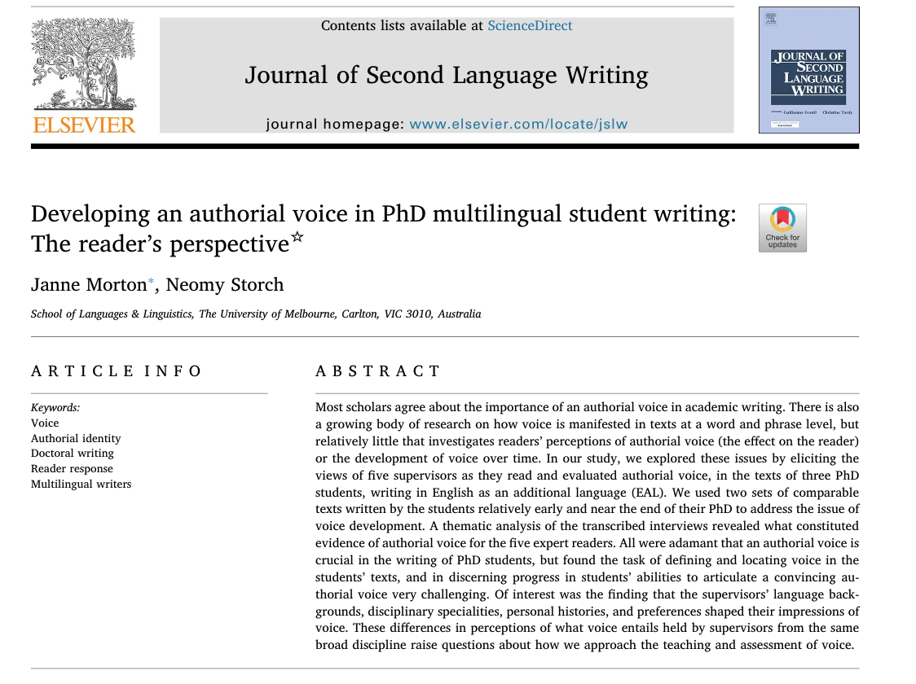

Slide 25
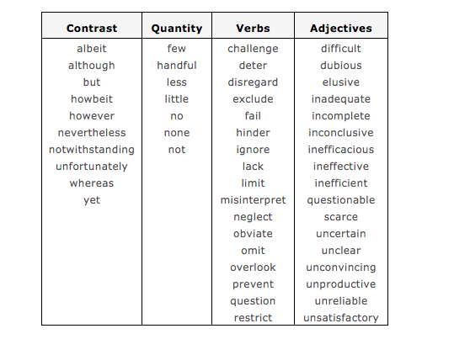
Establishing a research niche: specific terminology

Slide 26
Stage 4 – Developing your authorial voice
‘“Voice” doesn’t just refer to spoken words: it also implies the sense of a communicating presence behind written words. Without even using “I” or explicitly introducing the self, the choice, sequence, and rhythm of words establishes a witnessing evaluating presence. Largely because of voice, some writing magnetically commands attention – you can’t help but keep reading’.
(Kirin Narayan, 2012, quoted in Thomson, 2013)

Slide 27
What is wrong with...?
Literature review as:
Buds on the family tree
A series of summaries e.g. 'X says.... Y says ....'
Summaries followed by personal opinion e.g. 'They say, I say’
Quotomania/the 'quote dump’
The ‘invisible’ researcher

Slide 28
New buds on the family tree
Listing people/broad areas of research for being important to your work without saying why - announcing your influences without explaining why they are influential
Writing all about yourself and inserting unexplained citations to satisfy the literature review part

Slide 29
‘He said, she said...’
Adding more and more ideas without making a judgement or connection to your own study
Every sentence begins with a name: ‘X says this, Y says this’.

Slide 30
‘Quotomania’
Embroidery/collage - using phrases out of context
The quote dump or the ‘hit and run’ quotation - quote is left to speak for itself without making a case for its relevance to your argument
Instead, aiming for the quotation sandwich: introduction, quotation, explanation

Slide 31
Exercise 3
Giving a voice to the ‘invisible’ researcher: read and diagnose the issues with the following texts

Slide 33
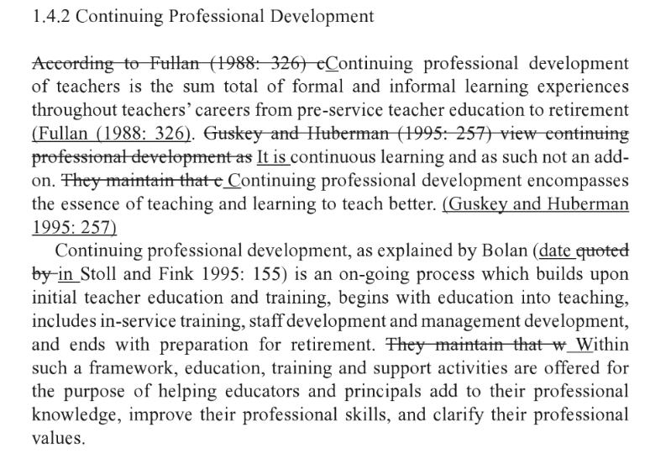

Slide 35
“The book addresses the problems that most doctoral researchers experience at some time during their candidature – being unclear about their contribution, feeling lost in the literature, feeling like an imposter, not knowing how to write with authority, wanting to edit rather than revise. Each chapter addresses a problem, suggests an alternative framing, and then offers strategies designed to address the real issue.”
Thomson and Kamler, 2016

Slide 36
Writing a background chapter (may or may not be in the lit rev)
Establishment of a context to locate a study in time, location, or culture.
Identification of current theory, discoveries, and debates, including an evaluation of those most useful and salient to your topic, as well as a nomination of gaps in literature .
Understanding of current practices and technologies in your field that highlight, and perhaps synthesize, a selection of the appropriate methods to gather data for your study.
Preliminary investigations done by you or others to help clarify research techniques, formulate hypotheses, or focus areas of investigation for the major research program to follow.
(How to write a better thesis, ch. 6, Evans, Gruba, Zobel, 2014)

Slide 37
Think of the old ‘you’, and what you knew before you got started on this particular research topic. That is the person your background is to be written for.
Learn to write defensively. Ask yourself: ‘If I were a reader, and I read this carelessly, or I didn’t really know the background literature, then what mistakes would I make?’
A: Write for your audience – examiners as primary audience

Slide 38
Exercise 4
Use the template to write a background introduction to your thesis

Slide 39
1. The study builds on and contributes to work in ________________________.
2. Although studies in ________________ have examined ____________ there has not been an ________________________________________________.
3. As such, this study provides additional insight into ____________________.
4. The analytic focus on ____________________ enables another contribution.
5. This study analyses ____________________________________________.
6. Although numerous studies ( ) have identified ________________________________________________, little analytic attention has been paid to ________________________________________________________.
7. I address this issue by demonstrating ____________________________________________________________________.

Slide 40
1. The thesis differs from other ________________________________________.
2. It owes a factual and interpretative debt to ________________________, ________________________ and ________________________________.

