Slide 1
WRITING AS ‘PRACTICE’
GSMD Doctoral Writing Workshop I / 6.10.20
Nick Bonadies / Nicholas.Bonadies@stu.gsmd.ac.uk
Practice:
A web of things we know ABOUT, and know HOW to do, because we work those physical and mental muscles regularly
Paying attention to what we DON’T KNOW
Finished products: ARTEFACTS of a PROCESS

Slide 2
WRITING AS ‘PRACTICE’
Rachael Cayley, Explorations of Style: A Blog about Academic Writing
Gravett et. al., Finding Your Way in Academic Writing

Slide 3
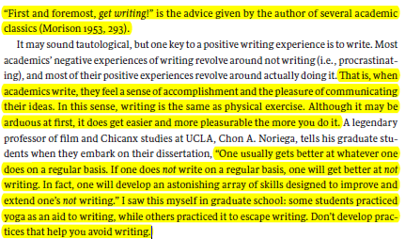
WRITING AS ‘PRACTICE’
Wendy Laura Belcher, Writing Your Journal Article in 12 Weeks
Joli Jensen, Write No Matter What: Advice for Academics

Slide 4
WRITING AS ‘PRACTICE’
SUMMARY:
GENERATES content, rather than REFLECTING content
Regular PRACTICE generates SKILL
Finished writing is an ARTEFACT of thinking-through-writing, a ‘PERFORMANCE’ of knowledge

Slide 5
WRITING AS ‘PRACTICE’
SUMMARY:
GENERATES content, rather than REFLECTING content
Regular PRACTICE generates SKILL
Finished writing is an ARTEFACT of thinking-through-writing, a ‘PERFORMANCE’ of knowledge
THOUGHTS FOR DISCUSSION:
WHAT GOES INTO A WRITING ‘PRACTICE’?
What, in your ‘practice’, HAS GOT YOU HUNG UP?
What’s going really WELL for you?

Slide 6
WRITING AS ‘PRACTICE’
SUMMARY:
GENERATES content, rather than REFLECTING content
Regular PRACTICE generates SKILL
Finished writing is an ARTEFACT of thinking-through-writing, a ‘PERFORMANCE’ of knowledge
THOUGHTS FOR DISCUSSION:
WHAT GOES INTO A WRITING ‘PRACTICE’?
What, in your ‘practice’, HAS GOT YOU HUNG UP?
What’s going really WELL for you?
Joli Jenson’s categories:
- TIME, SPACE, ENERGY, and (NB) SOCIAL INTERACTION

Slide 7
TIME
‘15 minutes a day’: establishing RHYTHM
(But that’s never gonna be enough)
Joli Jensen, Write No Matter What: Advice for Academics

Slide 8
TIME
‘15 minutes a day’: establishing RHYTHM
(But that’s never gonna be enough)
Joli Jensen, Write No Matter What: Advice for Academics
(… +ENERGY)

Slide 9
S P A C E
‘A DOOR THAT YOU’RE WILLING TO SHUT’
Joli Jensen, Write No Matter What: Advice for Academics

Slide 10
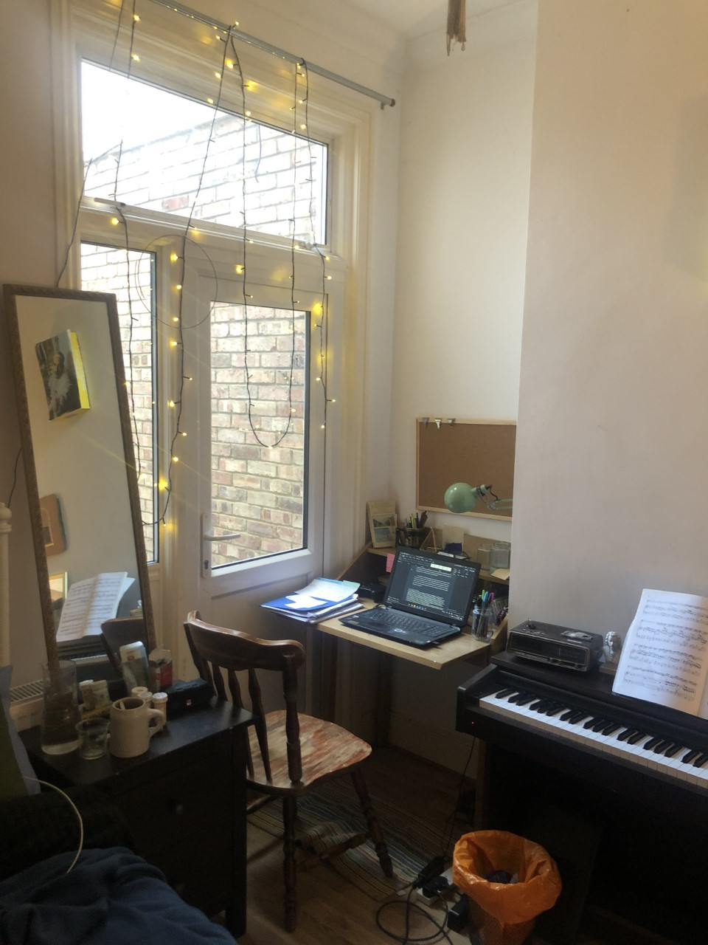
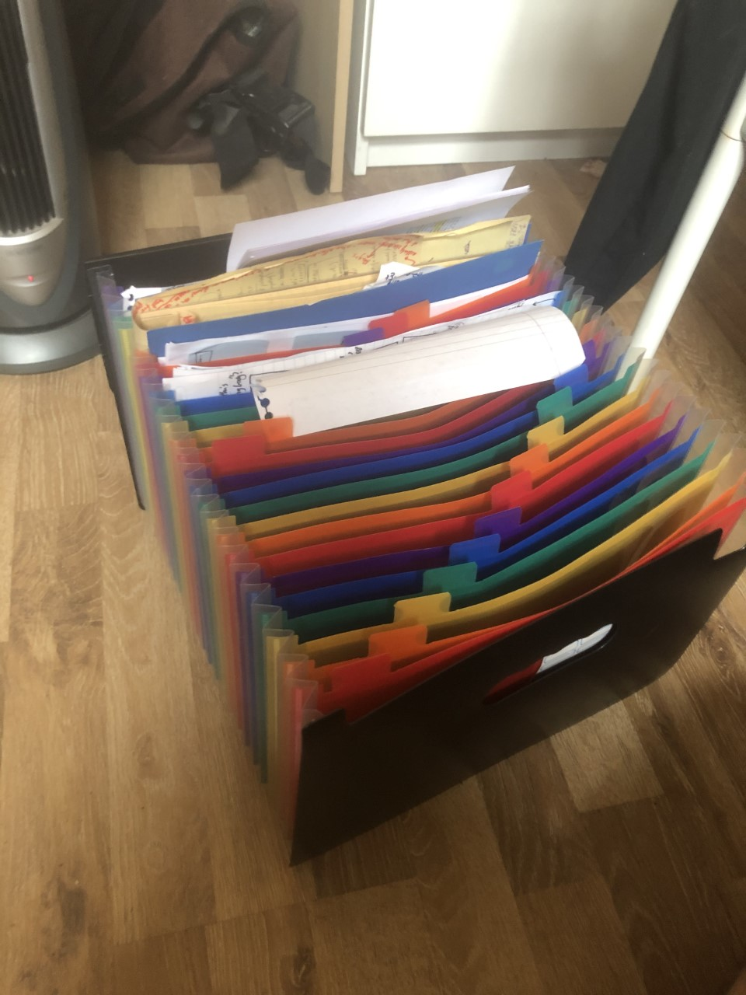
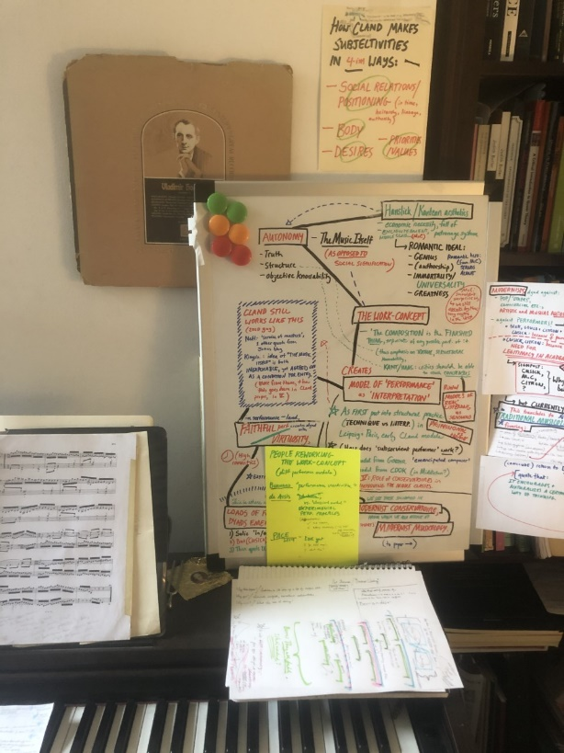
S P A C E

Slide 11
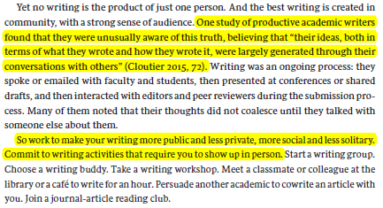
OTHER PEOPLE
Wendy Laura Belcher, Writing Your Journal Article in 12 Weeks

Slide 12
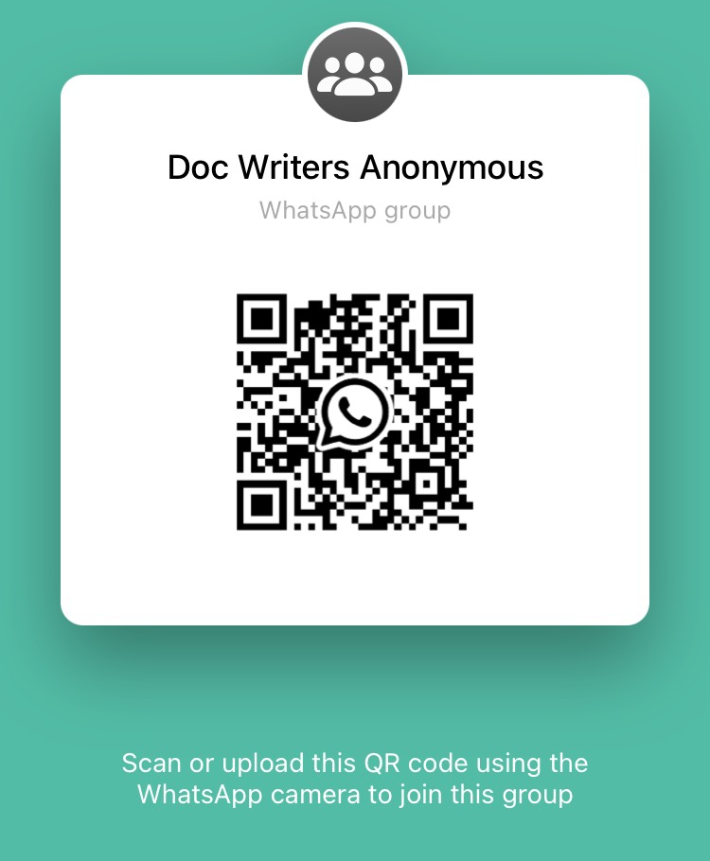
OTHER PEOPLE

Slide 13
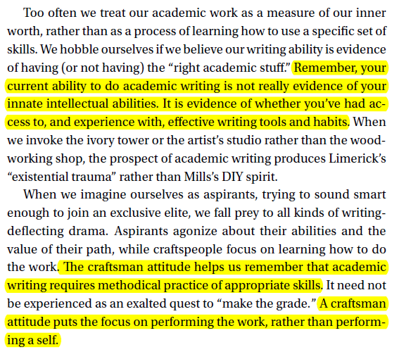
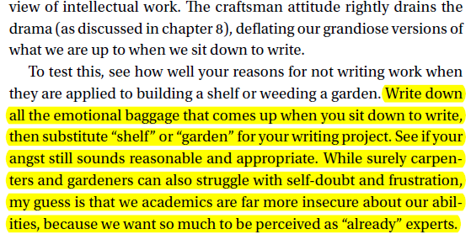
GETTING STARTED IS HARD
People generally don’t choose to self-sabotage
WHAT IS GETTING AT YOU ABOUT WRITING?
‘Craftsman’ attitude:
Joli Jensen, Write No Matter What: Advice for Academics

Slide 14
FOR DISCUSSION :)
SUMMARY:
GENERATES content, rather than REFLECTING content
Regular PRACTICE generates SKILL
Finished writing is an ARTEFACT of thinking-through-writing, a ‘PERFORMANCE’ of knowledge
THOUGHTS FOR DISCUSSION:
WHAT GOES INTO A WRITING ‘PRACTICE’?
What, in your ‘practice’, HAS GOT YOU HUNG UP?
What’s going really WELL for you?

